Slide 1
Getting Started with SharePoint Framework Extensions
Introduction to Extensions & Application Customizers
Notes:
Recorded session of this lesson available at:
https://www.youtube.com/watch?v=85DlxhbIK9I

Slide 2

Introduction to Extensions & Application Customizer
SPFx Extensions
Debugging & Testing Extensions
Deploying Extensions
Application Customizers

Slide 3
SharePoint Framework Extensions
Extend the SharePoint user experience
Customize notification areas, toolbars & list data views
Available in Modern pages, lists & libraries
SharePoint Online
SharePoint Server 2019
Used to implement popular customizations from previous development models
Delegate controls & ScriptLink
Client-Side Rendering & JSLink
Custom Actions

Slide 4
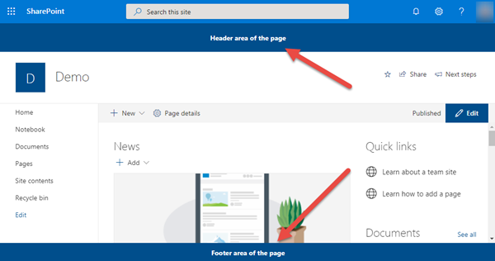
Application Customizers
Add script to any page, header & footer controls

Slide 5
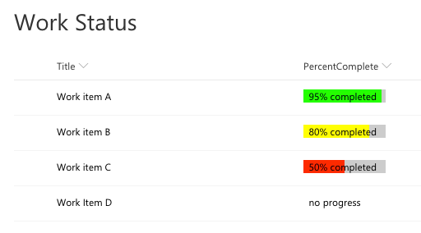
Field Customizers
Customize rendering of a list column in modern lists

Slide 6
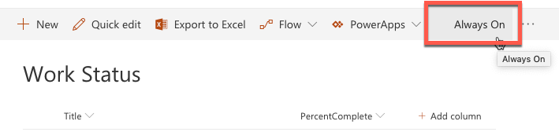
Command Sets
Add buttons to list & library toolbars & context menus

Slide 7
Project Structure
.vscode: includes Visual Studio Code integration files
config: includes all config files
dist: created automatically on builds – contains out from bundle process
lib: created automatically on builds – contains pre-bundled built files
node_modules: created automatically when installing all package dependencies with a package manager
sharepoint: contains assets needed for deployment
src: this is the main folder of the project, it includes the extension, styles, and a test file
temp: created automatically on builds - contains local dev webserver files
Notes:
All of these components we’ve seen in previous lessons. The difference this time is that the src folder doesn’t contain the webpart code, but the extension code instead.

Slide 8
Debugging & Testing Extensions
Unlike web parts, extensions require a live SharePoint site, list and/or library
Can still build and host extension project locally while testing in a remote SharePoint site
Similar experience to using hosted SharePoint workbench for web part development, testing & debugging
Configurations added to each project by the SPFx Yeoman generator simplifying loading SharePoint sites
Instructs SharePoint to load SPFx & manifest file from https://localhost

Slide 9
Deployment of Extensions
Extension deployment utilizes existing Feature framework
Application customizer: <CustomAction>
Field customizer: <Field>
Command set: <CustomAction>
Deployment similar to web parts
Upload SharePoint Package to tenant or site collection app catalog
Install app
Some extensions type support tenant-wide deployment

Slide 10
Tenant Wide Deployment
Centralized control of which extensions are available across entire tenant
Consistent end-user experience across all sites
Consistent deployment across all sites
Automatically enable functionality on newly created sites

Slide 11
Tenant Wide Deployment
Automatically deploy extension to all sites in a SharePoint Online tenant
Bypasses need for installation in each site collection
Supported for application customizers & list view command sets
Make available for specific web or list templates
Specify public properties on extension across all sites
Default experience by presence of ClientSideInstances.xml in *.sppkg
Delete this file if tenant wide deployment not desired

Slide 12
List: Tenant Wide Extensions
Control tenant wide deployments with this app catalog list
Column | Type | Description
Title | string | Title of the entry. Can be descriptive entry for the registration. Doesn’t have to match anything, just for your reference
Component ID | GUID | Manifest ID of the component. Has to be in GUID format and component must exists in the app catalog.
Component Properties | string | Optional component properties.
Web Template | string | Can be used to target extension only to specific web template.
List Template | int | List type as a number.
Location | string | Location of the entry. There are different support locations for application customizers and List View Command Sets.
Sequence | int | Sequence of the entry in rendering.
Disabled | Boolean | Enabled state of the deployment.

Slide 13
Application Customizers
Add HTML or JavaScript to all pages in a SharePoint site
Similar to pre-SPFx / classic mode customizations
Delegate control
ScriptLink control
Example scenarios
Add script to every page
Add 3rd party libraries to every page (ie: Azure Application Insights)
Add notice to all pages such as: alerts, news or privacy

Slide 14
Application Customizer - Placeholders
Two well-known placeholders exist on all pages
Header (just below Office 365 suite bar)
Footer (bottom of page)
Placeholders are sticky & always visible

Slide 15
Application Customer
export interface IHelloAppCustomizerApplicationCustomizerProperties {
prefixString: string;
}
export default class HelloAppCustomizerApplicationCustomizer
extends BaseApplicationCustomizer<IHelloAppCustomizerApplicationCustomizerProperties> {
private _topPlaceholder: PlaceholderContent | undefined;
private _bottomPlaceholder: PlaceholderContent | undefined;
@override
public onInit(): Promise<void> {
// this is where you do your work
}
private _onDispose(): void {
}
}

Slide 16
Demo Creating SharePoint Framework Application Customizers
Notes:
Demo steps:
https://github.com/SharePoint/sp-dev-training-spfx-extensions/tree/master/Demos/01-appcustomizer

Slide 17
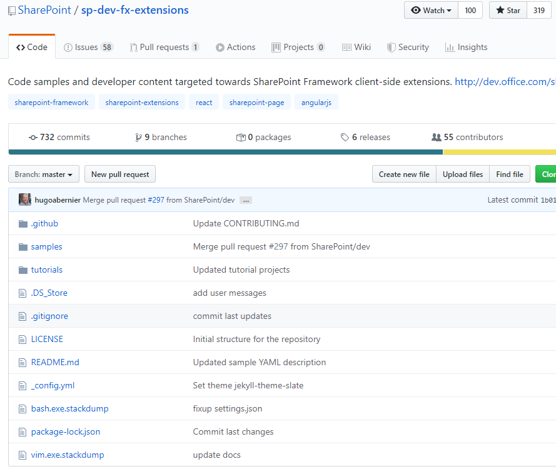
SPFx Extension Samples
Lot’s of good samples are available in GitHub
Don’t reinvent the wheel
https://github.com/SharePoint/sp-dev-fx-extensions

Slide 18

Summary
SPFx Extensions
Debugging & Testing Extensions
Deploying Extensions
Application Customizers

Slide 19
SharePoint Framework Extensions: Field Customizers
Field Customizers

Slide 20
Field Customizers
Overview
Debugging & Testing
Deploying

Slide 21
Field Customizer
Customize rendering of cell in list view display mode
Similar to pre-SPFx / classic mode customizations
Client-Side Rendering (CSR)
JSLink
Example scenarios
Display picture or illustration in field instead of text
Make a field rendering interactive
Add React component to field rendering

Slide 22
Field Customizer Class
export interface IPercentCompleteFieldCustomizerProperties {
yellowMinLimit?: string;
}
export default class PercentCompleteFieldCustomizer
extends BaseFieldCustomizer<IPercentCompleteFieldCustomizerProperties> {
@override
public onInit(): Promise<void> {
}
@override
public onRenderCell(event: IFieldCustomizerCellEventParameters): void {
// called when rendering the cell
}
@override
public onDisposeCell(event: IFieldCustomizerCellEventParameters): void {
}
}

Slide 23
Deploying Field Customizers as a Site Column
<Field ID="{0ebe7606-20f4-49be-bcdc-2dfc65348b46}"
Name="PercentageComplete"
DisplayName="Percentage Complete"
Type="Number"
Min="0"
Required="FALSE"
Group="SPFx Columns"
ClientSideComponentId="fcedd96a-1c34-4ac8-9ad8-5aaf4cb1e993"
ClientSideComponentProperties= "{&quot;greenMinLimit&quot;:&quot;85&quot;,&quot;yellowMinLimit&quot;:&quot;70&quot;}">
</Field>

Slide 24
Debugging & Testing Field Customizers
Unlike web parts, extensions require a live SharePoint list and/or library
Can still build and host extension project locally while testing in a remote SharePoint site
Similar experience to using hosted SharePoint workbench for web part development, testing & debugging
Configurations added to each project by the SPFx Yeoman generator simplifying loading SharePoint sites

Slide 25
Testing Field Customizers – How it Works
URL parameters instruct SharePoint to:
Load SPFx & manifest file from https://localhost
Associate a specific field rendering with the custom JavaScript
Must specify the internal name of a field to associate with the field customizer JavaScript

Slide 26
Deployment of Field Customizers
Extension deployment utilizes existing Feature framework
<Field>
Can be provisioned as a new site column
Deployment similar to web parts
Upload SharePoint Package to tenant or site collection app catalog
Install app to add site column
Can be also associated to existing site columns or fields in the SharePoint sites
Set ClientSideComponentId and ClientSideComponentProperties properties in Field object

Slide 27
Demo Creating SharePoint Framework Field Customizers
Notes:
Demo steps;
https://github.com/SharePoint/sp-dev-training-spfx-extensions/tree/master/Demos/02-fieldcustomizer

Slide 28
Summary
Overview
Debugging & Testing
Deploying

Slide 29
SharePoint Framework Extensions: List View Command Set
List View Command Sets

Slide 30
Command Sets
Overview
Debugging & Testing
Deploying

Slide 31
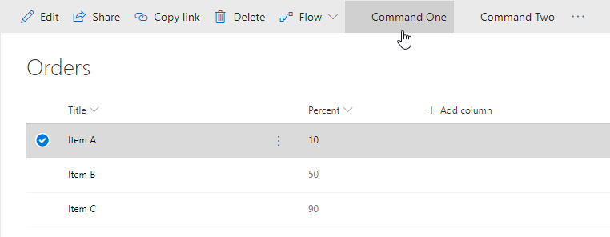
List View Command Sets
Add buttons to modern lists & libraries
Add to toolbar
Add to item context menus
Or both!
Control visibility state of button based on state of view
Similar to pre-SPFx / classic mode customizations
Custom actions
Example scenarios
Start external process
Execute custom script when clicked

Slide 32
Defining Command Set Buttons
// *.manifest.json
{
"items": {
"ONE_ITEM_SELECTED": {
"title": { "default": "One Item Selected" },
"iconImageUrl": "icons/request.png",
"type": "command"
},
"ALWAYS_ON": {
"title": { "default": "Always On" },
"iconImageUrl": "icons/cancel.png",
"type": "command"
}
}
}

Slide 33
Command Set Class
export interface ICommandSetDemoCommandSetProperties {
messagePrefix: string;
}
export default class CommandSetDemoCommandSet
extends BaseListViewCommandSet<ICommandSetDemoCommandSetProperties> {
@override
public onInit(): Promise<void> {
}
@override
public onListViewUpdated(event: IListViewCommandSetListViewUpdatedParameters): void {
// fired when state of list view changes
}
@override
public onExecute(event: IListViewCommandSetExecuteEventParameters): void {
// what happens when button is selected
}
}

Slide 34
Debugging & Testing Command Sets
Unlike web parts, extensions require a live SharePoint list and/or library
Can still build and host extension project locally while testing in a remote SharePoint site
Similar experience to using hosted SharePoint workbench for web part development, testing & debugging
Configurations added to each project by the SPFx Yeoman generator simplifying loading SharePoint sites

Slide 35
Deployment of Command Sets
Extension deployment utilizes existing Feature framework
Command set: <CustomAction>
Deployment similar to web parts
Upload SharePoint Package to tenant or site collection app catalog
Install app
Some extensions type support tenant-wide deployment

Slide 36
Demo Creating SharePoint Framework List View Command Sets
Notes:
Demo steps;
https://github.com/SharePoint/sp-dev-training-spfx-extensions/tree/master/Demos/03-listviewcommandset

Slide 37
Summary
Overview
Debugging & Testing
Deploying

Slide 38
Reading further
Overview of the SharePoint Framework
https://docs.microsoft.com/sharepoint/dev/spfx/sharepoint-framework-overview
Overview of SharePoint Framework Extensions
https://docs.microsoft.com/sharepoint/dev/spfx/extensions/overview-extensions
Build your First ListView Command Set extension
https://docs.microsoft.com/en-us/sharepoint/dev/spfx/extensions/get-started/building-simple-cmdset-with-dialog-api
Build your First Field Customizer Extension
https://docs.microsoft.com/sharepoint/dev/spfx/extensions/get-started/building-simple-field-customizer

Slide 39
Reading further
Use Page Placeholders from Application Customizer
https://docs.microsoft.com/sharepoint/dev/spfx/extensions/get-started/using-page-placeholder-with-extensions
Tenant Wide Deployment of SharePoint Framework Extensions
https://docs.microsoft.com/sharepoint/dev/spfx/extensions/basics/tenant-wide-deployment-extensions

Slide 40
Lab In this lab you work with the SharePoint Framework to extend the user interface with extensions. This includes: application customers, field customizers and command sets. aka.ms/spdevwsM4L5
Notes:
Lab manual at:
https://aka.ms/spdevwsm4l5

